Slide 1
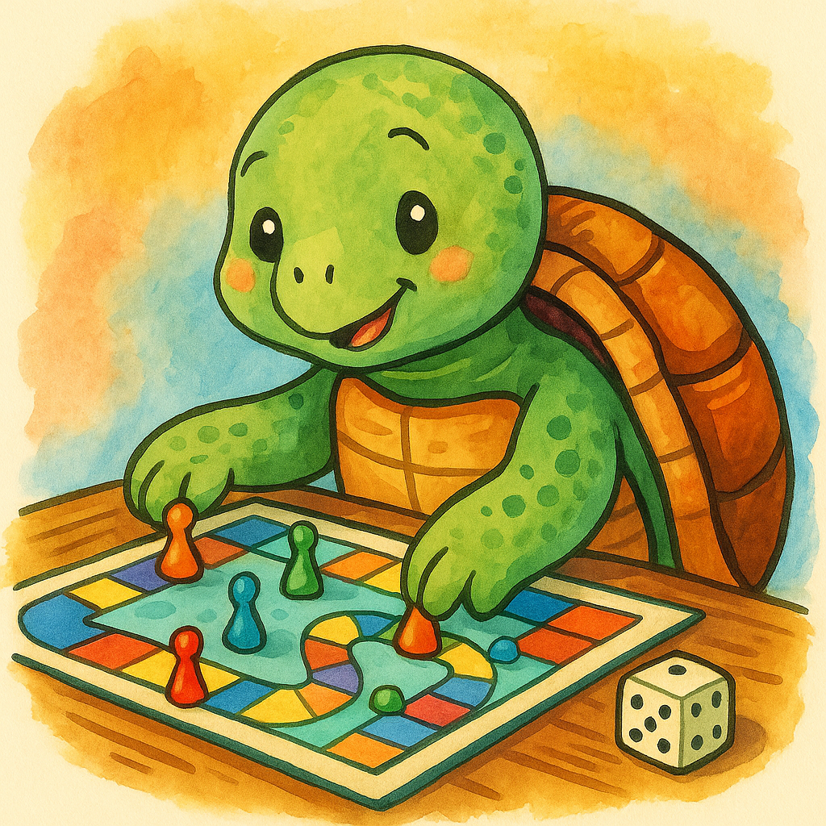
Turtle Games — Customer Loyalty Analytics
Prepared for: Turtle Games
Prepared by: ANDREW WILLACY
Date: 6th October 2025
Notes:
Hello and welcome to my presentation on our analysis of data supplied by Turtle Games. I’ll walk through what we set out to learn, the tools used, the headline insights about customer loyalty, and a short set of business recommendations.

Slide 2
Agenda
Objective & business questions
Data & tools leveraged
What we found (high-level)
How we modelled loyalty (simple vs flexible)
Segments & customer sentiment
Recommendations & next steps
Notes:
I’ll start with the business goal and questions, describe the data and tools leveraged, summarise the key patterns we found, compare two predictive approaches, share segmentation and sentiment results, then wrap with actionable insights

Slide 3
What we set out to achieve
The Questions:
How do customers engage & accumulate loyalty points
How can text data be used to inform marketing campaigns
Predict loyalty points from simple drivers for day‑to‑day decisions.
Identify segments and messages to grow value, not just measure it.
Notes:
Our goal was practical: explain and predict loyalty points, find customer groups to target and how, and turn findings into actions that can raise customer value. This will include building predictive models to look at relationships between variables, looking at potential customer segmentation and leveraging NPL to analyse customer reviews and determine sentiment.
We worked from a cleaned dataset with 2,000 rows across nine data points per customer using Python and R

Slide 4
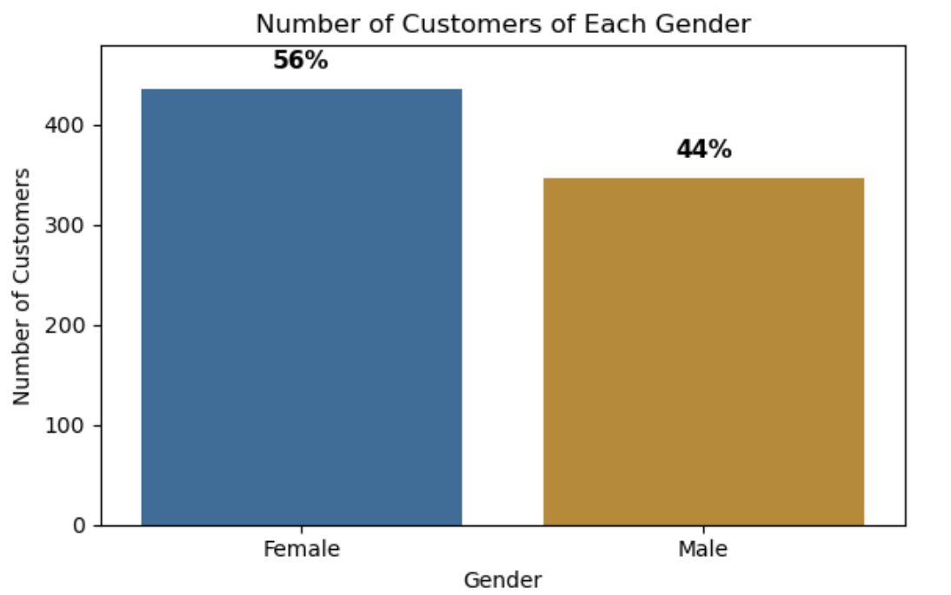
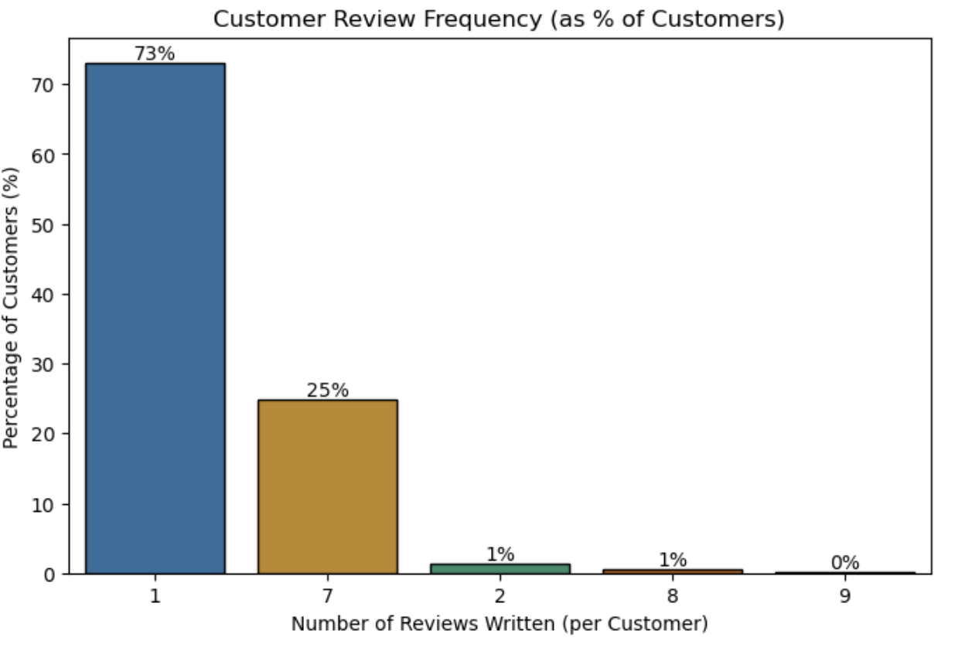
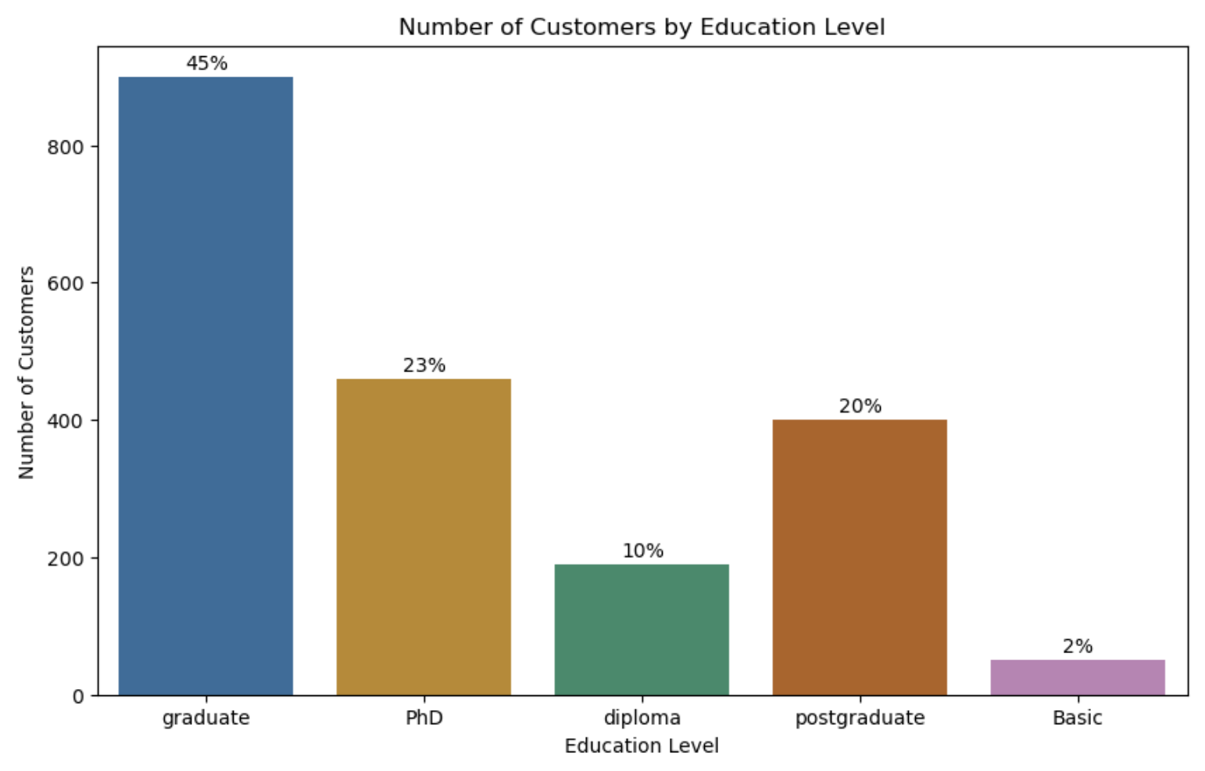
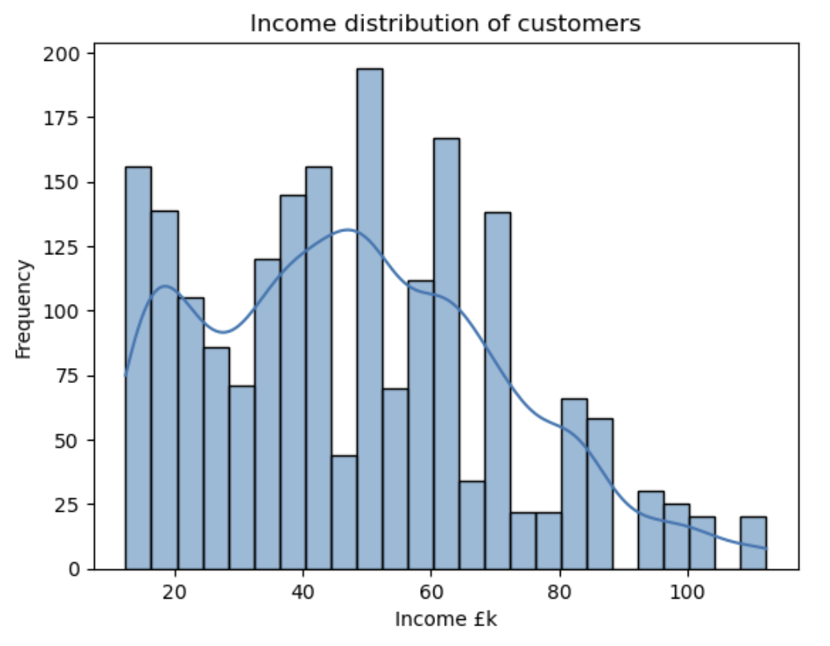
Getting to know the customers
Notes:
We started with some basic demographic analysis to get to know the customers. Females out number males by 1 : 0.8. Most customers only write the one review, although curiously the next largest group at 25 wrote 7 reviews.
In terms of education, customers come from a variety of backgrounds, but graduates dominate./
Income wise, there is a wide spread, there are peaks and troths across the range

Slide 5
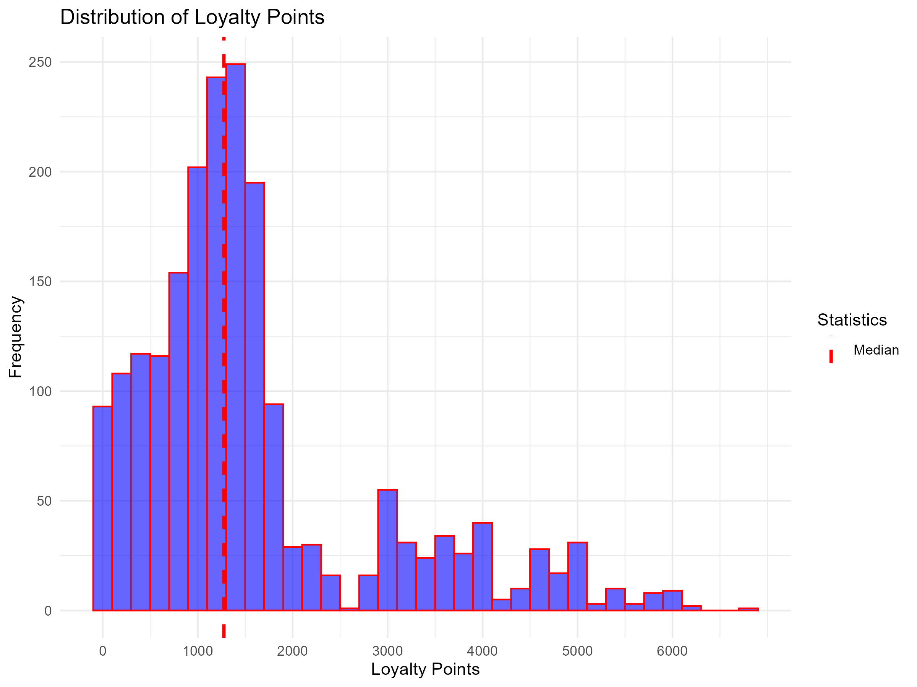
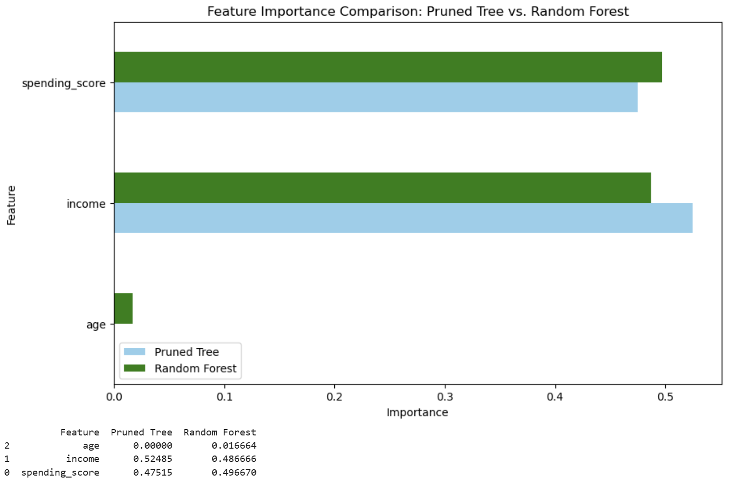
What we observed (high‑level EDA)
Loyalty points are right‑skewed; ≈13% high‑value outliers.
Spending score and income align with loyalty; age contributes modestly.
Notes:
Three quick patterns stood out. First, loyalty points are right‑skewed with a notable high‑value tail (about 13% outliers). So the bulk of customers have less than 2000 loyalty points. Second, spending score and income are the strongest correlation with loyalty points, age is positive but smaller. Other factors (including external) played a lesser role.

Slide 6
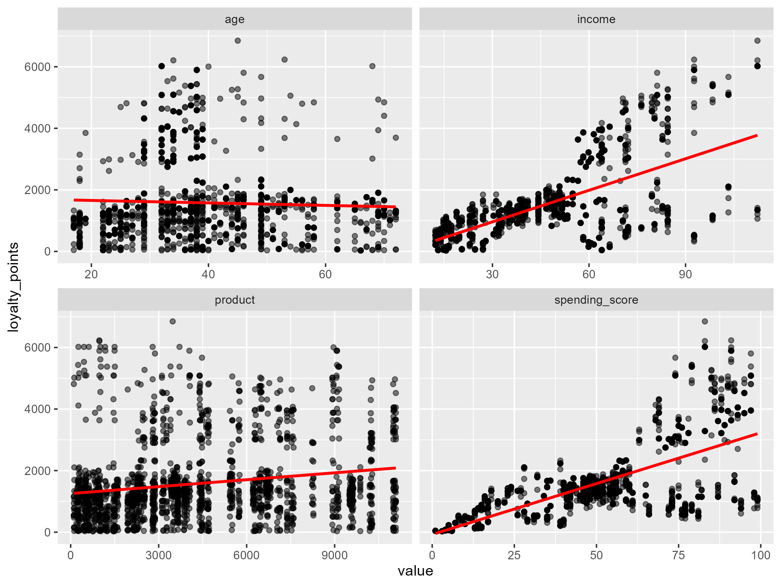
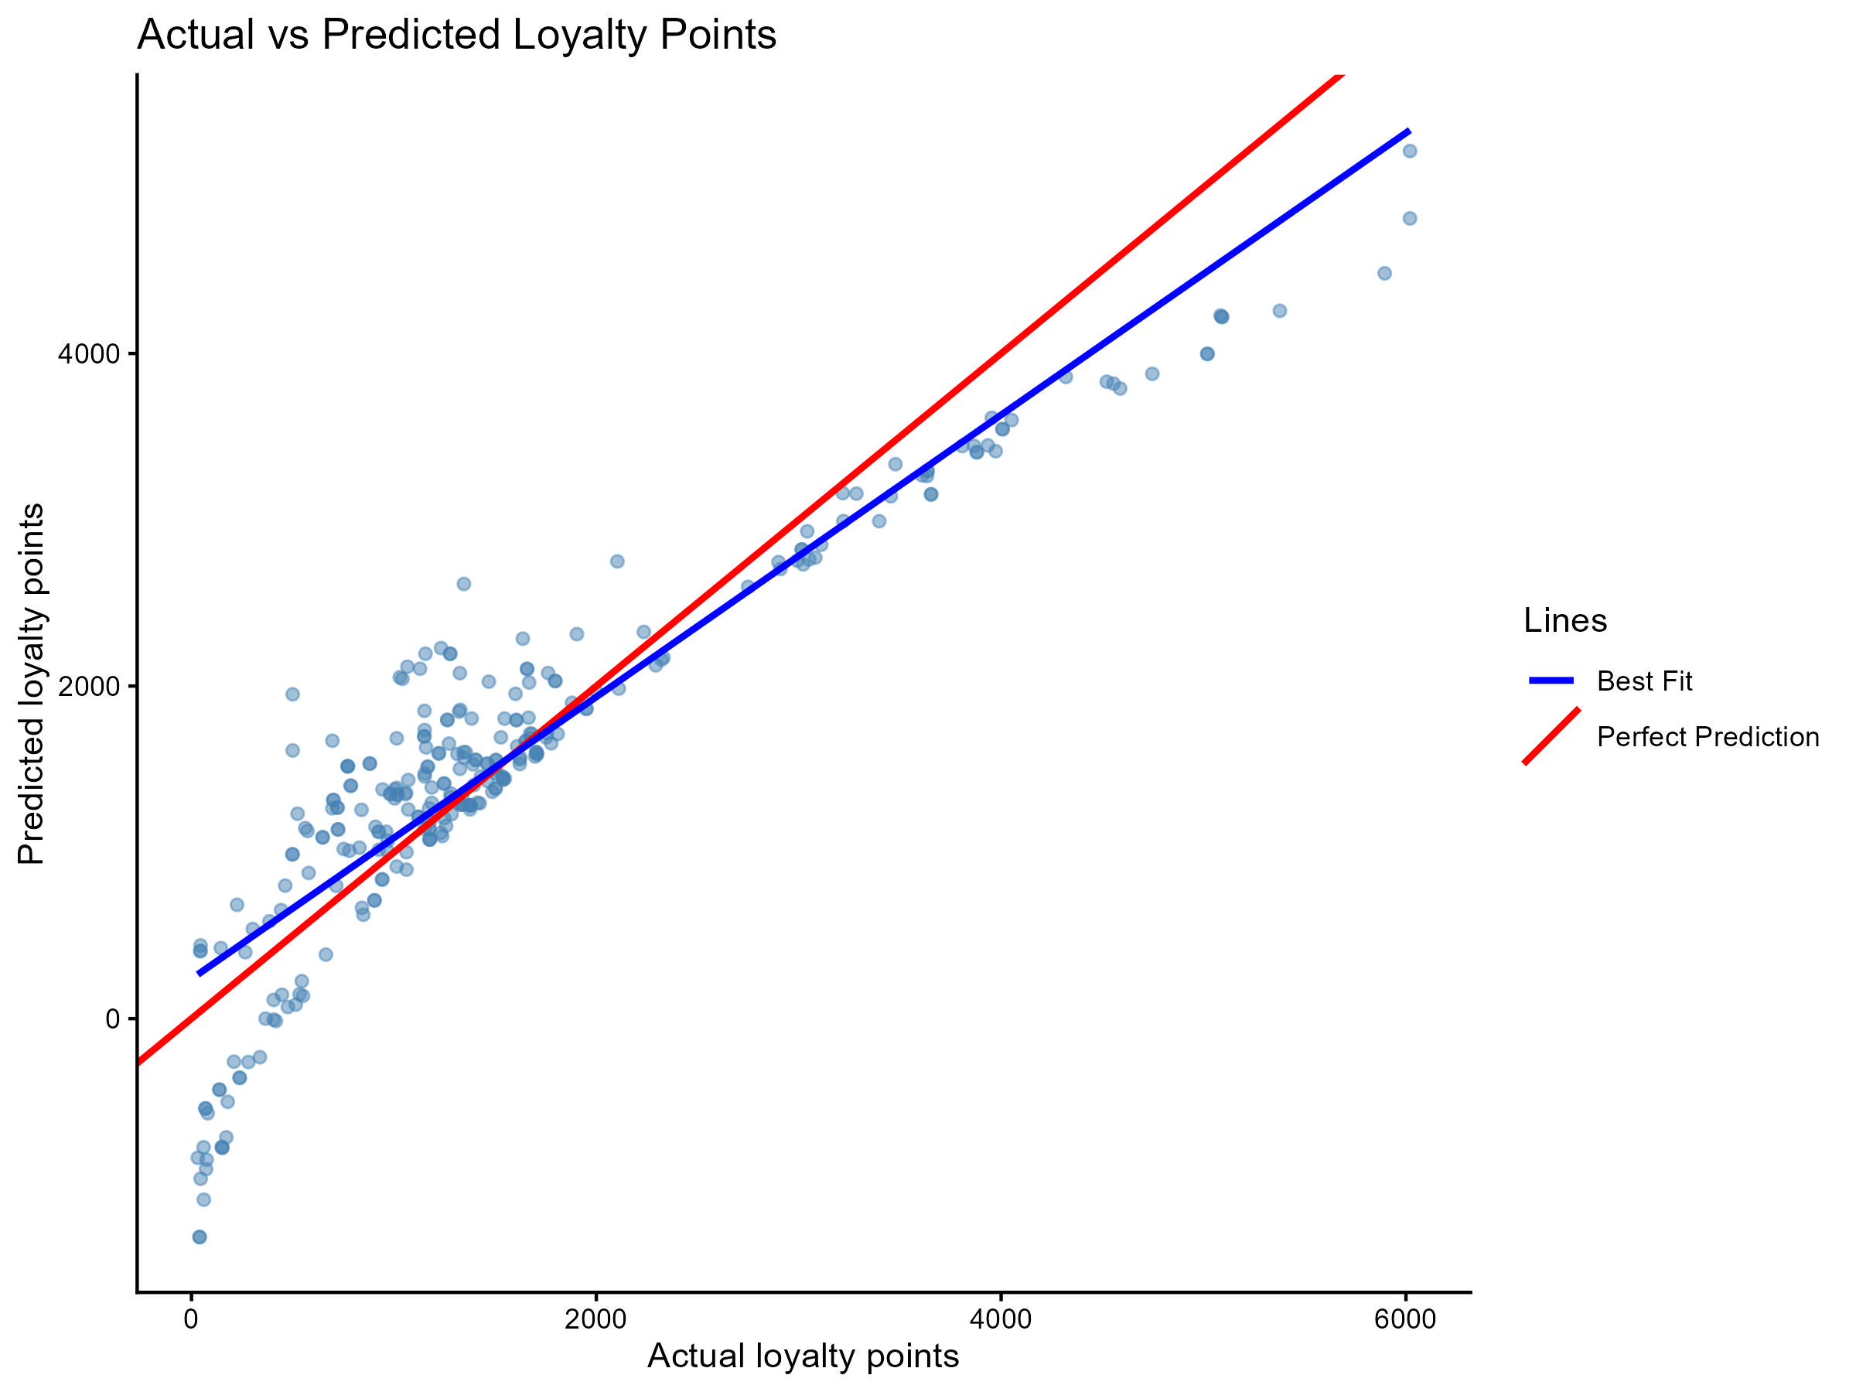
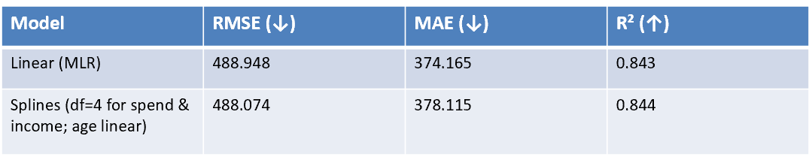
Linear Regression
To compute any statistical significance and relationship between these numerical variables on loyalty points, we used linear regression models to plot visualisations
Notes:
Looking at linear regression (both simple and multiple) we can see if there are any potential relationships between the variables. Spending score and income do indeed have an impact on loyalty points, to an extent. After a spending score or income of 60, things are less linear, we see the spread of data points, suggesting that we may be able to predict loyalty points up to this point. After this it’s more difficult and linear models won’t be so useful. On the righ graph we can see the predicted loyalty by observed ;oyalty, meaning we over estimate at lower scores, and under estimate at higher scores.
Age and product are random across the range.
Spline regression allows us to take into consideration a less linear approach, but the results were very similar to linear, not offering any real benefits.

Slide 7
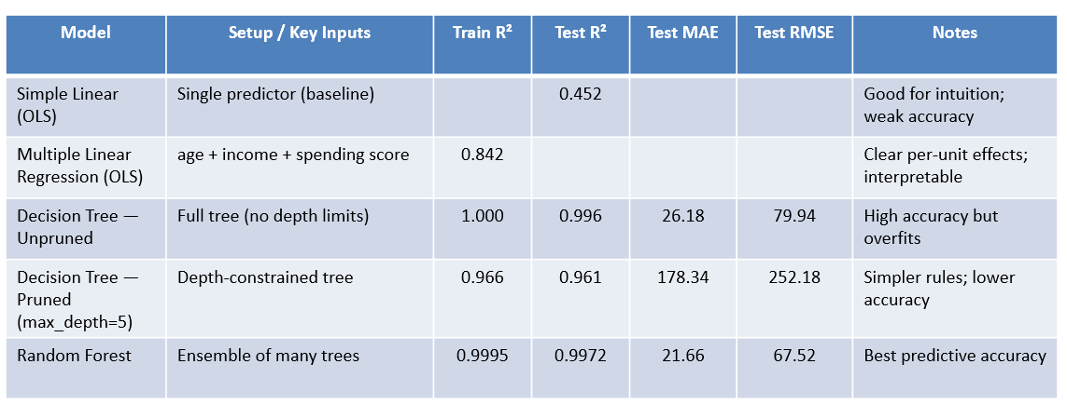
Key Insights on models to predict loyalty points
Linear models vs. Decision Trees vs. Random Forest (Turtle Games)
Random Forest delivers the most accurate predictions on new data (lowest Test RMSE/MAE, highest Test R²).
Pruned Tree and Multiple Linear Regression are easier to explain to stakeholders; use them for policy and communication.
Spending score and income drive loyalty far more than age across all models.
Notes:
Using decision trees made it easier to compare models, unpruned, pruned and random forests. Random Forest gave the best test accuracy, so it’s strongest for prediction, but less interpretable. Pruned trees are easier to explain but lose accuracy. Linear models are simple and explain drivers clearly (spending score and income dominate), but the simple linear fit is weak , explaining 45% of the variation in loyalty points) can be explained by spending score. Multiple linear improves a lot , taking that to a decent 84% and is the best choice when we need explainability for stakeholders. That does leave 16% unaccounted for, but this could be caused by factors outside of our control.
Business takeaway: For operational forecasts, use Random Forest. For decision rules and storytelling with non-technical stakeholders, use the pruned tree (depth≈5) or the multiple linear model. Across models, spending score and income are the main levers for loyalty points; age has a smaller effect.

Slide 8
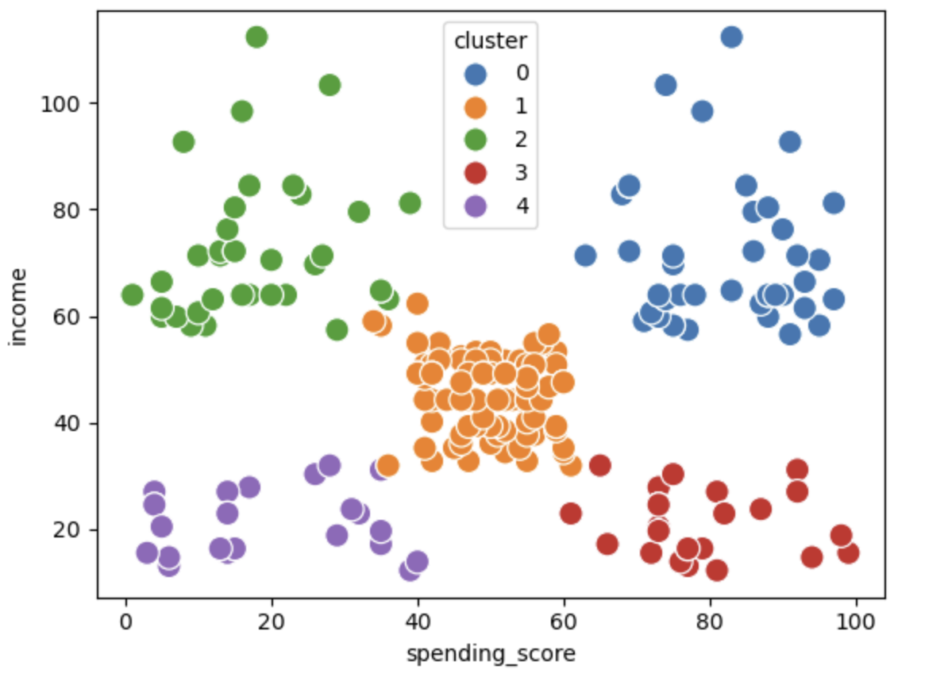
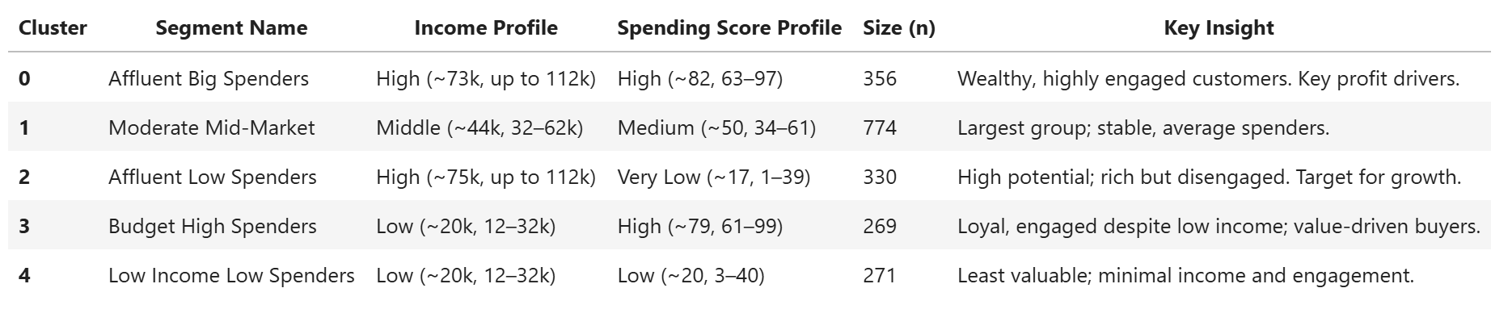
Customer segments (k‑means k=5)
Can we segment customers into groups for target specific marketing?
Placeholder: Insert cluster scatter/centroids visua here
Notes:
Next we looked at customer grouping or segmentation. Can the customers be split into easily definable groups. As it turns out, yes.
We found five workable segments. For example, high income / low spend is ripe for enguagement, while high income / high spend is ideal for VIP treatment. The mid‑income/mid‑spend group is the largest.
But this segmentation, only looked at spending score and income, we saw earlier age also had a potential part to play.

Slide 9
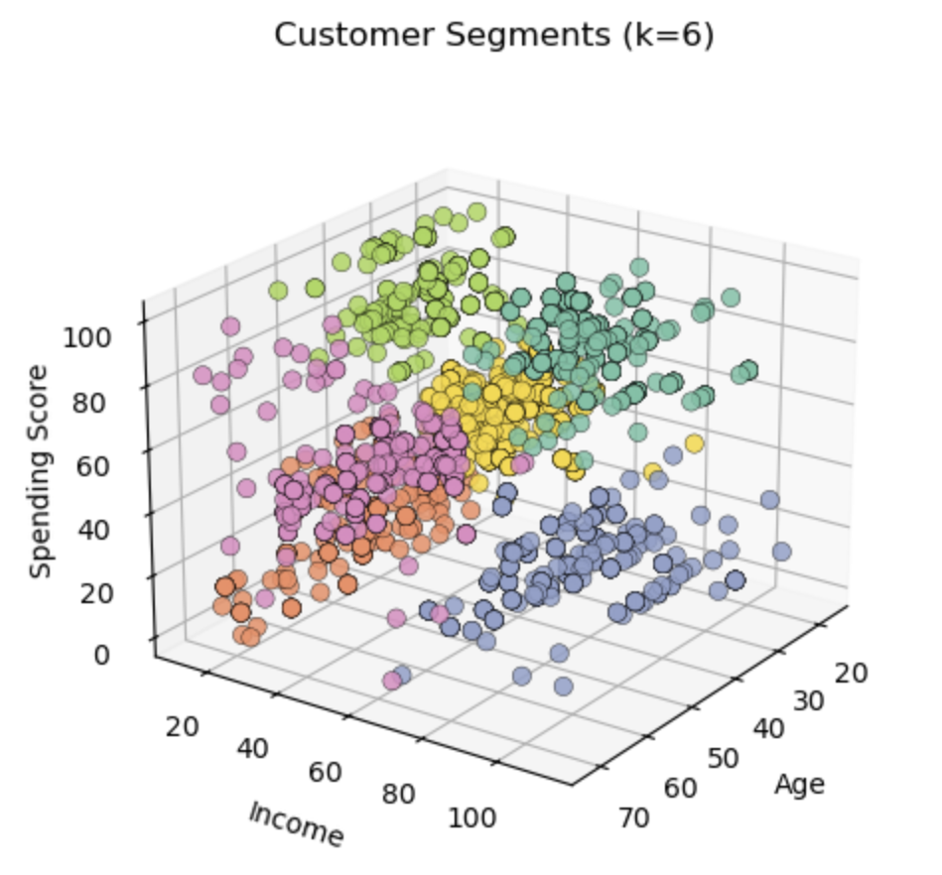
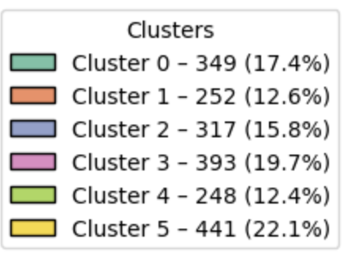
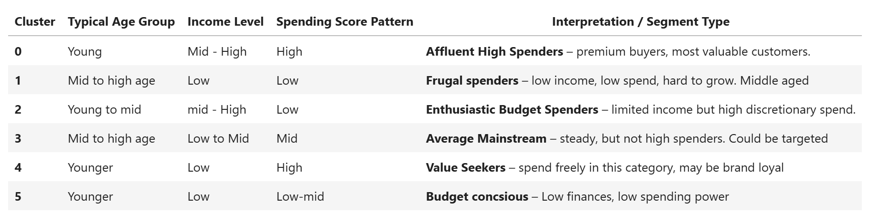
Customer segments: (K-Means k=6)
Notes:
Lets add age into the mix. This time we split the customers into six distinct groups. Now we have segmented by age, it gives us a better understanding of customer circumstances. For example younger customers or grand parents with limited budgets, to the affluent high spenders.

Slide 10
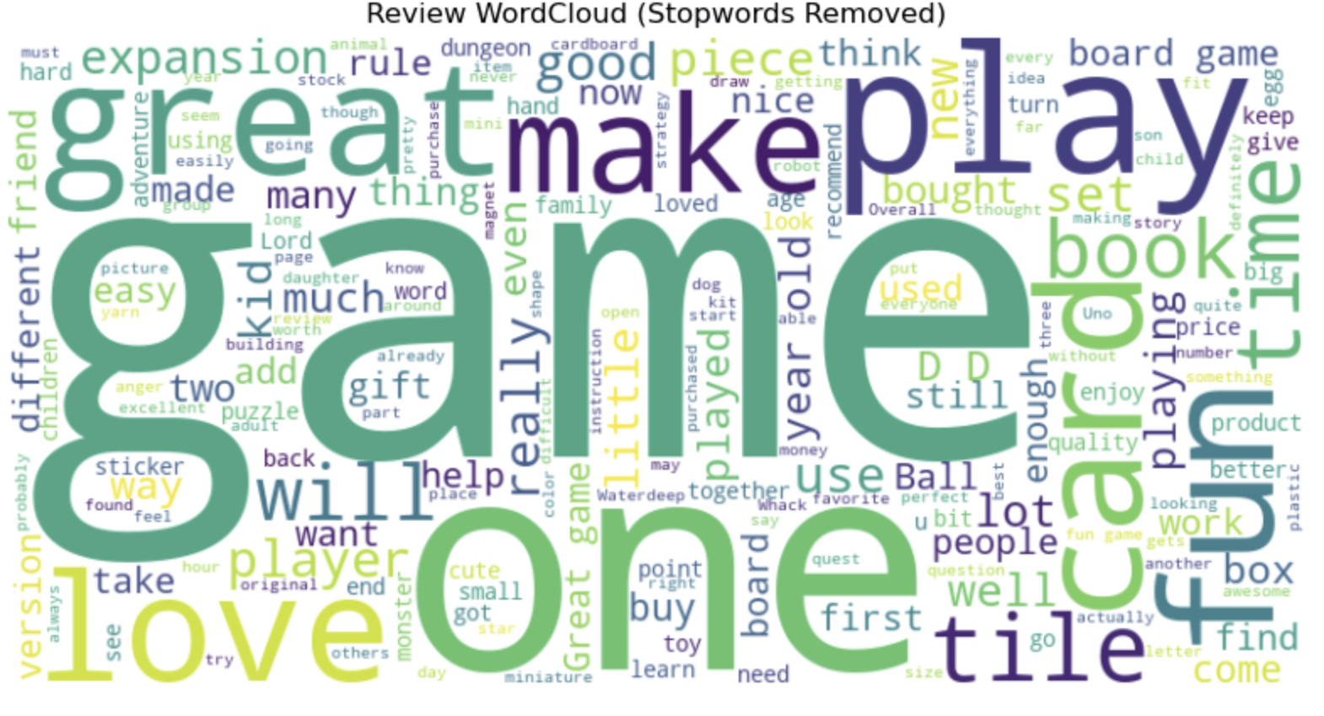
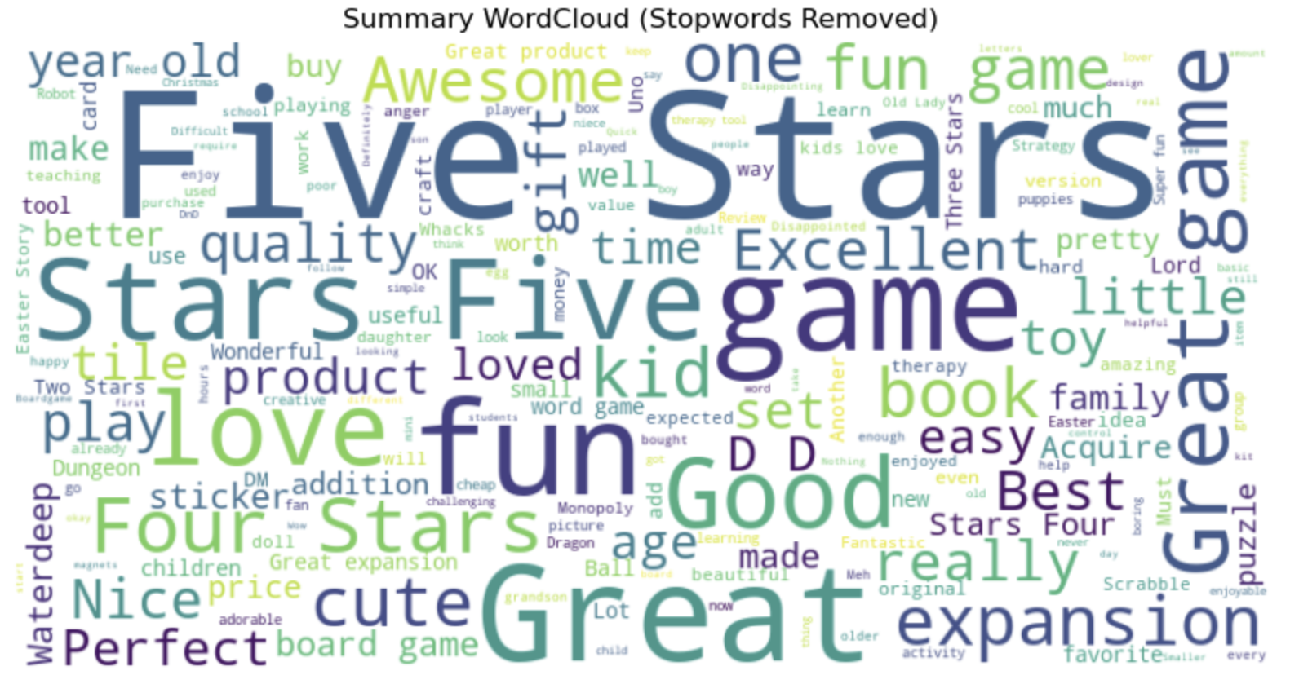
Customer voice (reviews & sentiment)
Most common positive themes: “game”, “fun”, “quality”, “kids”, “easy”, “pieces”.
Top positives: quality, replay value, educational benefits.
Top negatives: missing pieces, packaging, shipping delays.
Action: keep leaning into family‑fun quality; fix fulfilment friction points.
Notes:
Our final analysis looked at customer sentiment, through reviews. Sometime reviews speak louder than a simple star rating and allows us to really dig into their true feelings.
Most common themes
Most common words
The brand promise resonates—fun, quality, easy for families. We should ensure operations deliver consistently t(this seems to be the source of negativity) to protect that equity.

Slide 11
Top Positive & Negative Words
Top positive words
Positive Keywords | Insight
game | Central to product identity; highlights enjoyment.
fun | Strong association with customer satisfaction.
quality | Customers value durability and design.
kids | Products resonate well with families.
easy | Ease of use/setup is appreciated.
Top negative words
Negative Keywords | Insight
pieces | Complaints about missing/broken parts.
shipping | Delays or damaged packages mentioned.
broken | Quality control/packaging issues.
instructions | Poor or unclear manuals frustrate customers.
expensive | Some perceive pricing as high for value.
Notes:
Here is a very brief look at the most frequently used words across review and summary

Slide 12
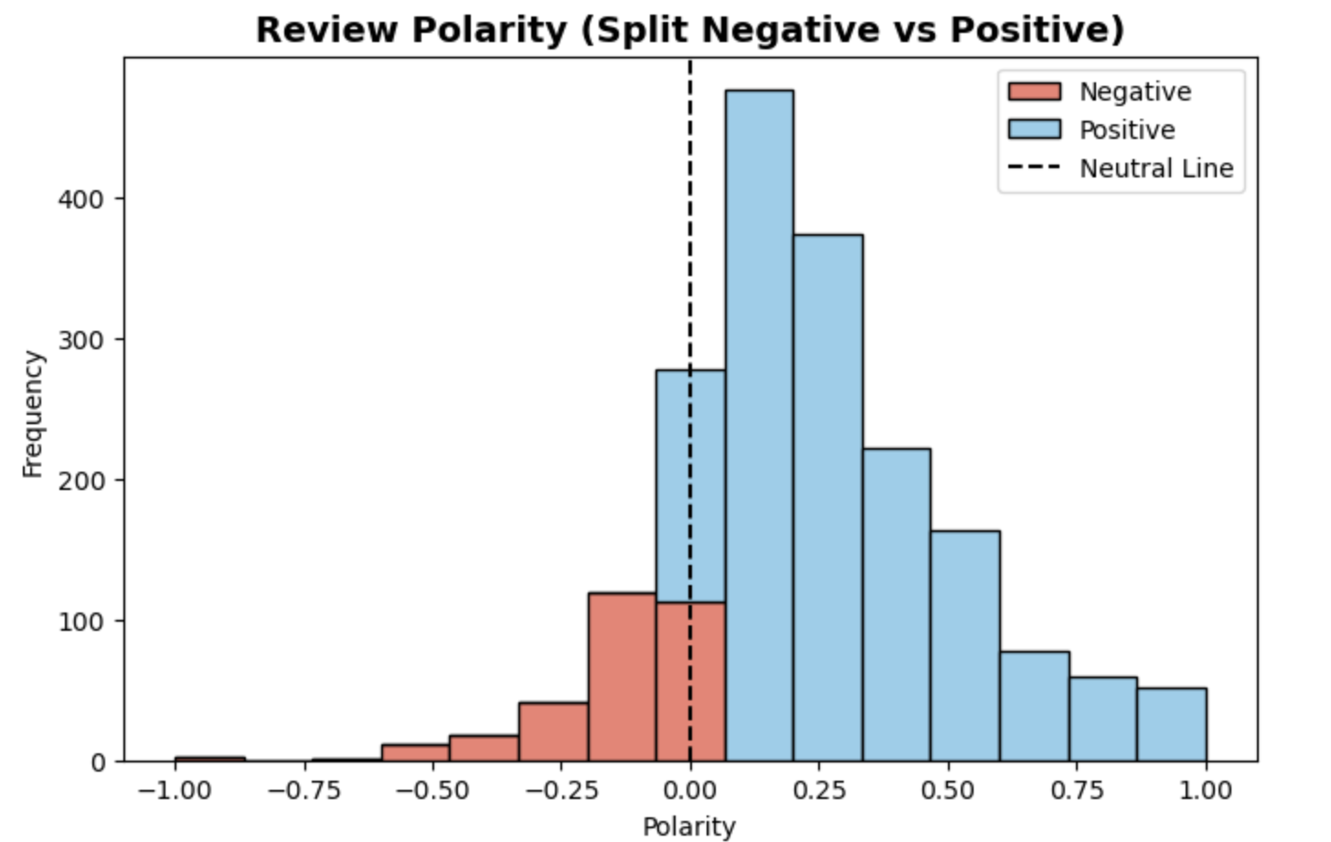
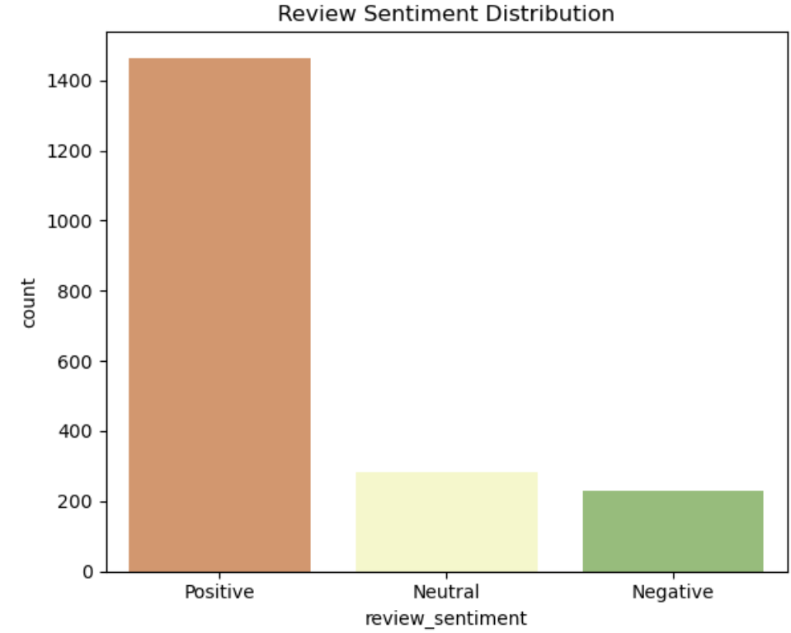
Review sentiment polarity
Notes:
Review sentiment. We can see that on the whole customers are happy with Turtle games. Sentiment is generally positive. It would be advisable to look into the negativity though

Slide 13
Key Insights
Simple drivers (spending score, income) 84% of loyalty variation.
There is a small but important VIP tail (≥3,200 points).
Segments are distinct enough to target with different tactics.
Operational issues—not product—cause most negative reviews.
Notes:
In short: we can explain and predict loyalty reasonably well; we know who the premium customers are; and we know where operations can improve the experience.

Slide 14
Recommendations
Marketing strategy:
Emphasise fun, quality, family enjoyment in messaging.
Tailor campaigns by cluster: premium offers for high-spend customers; loyalty rewards for mid-income segments.
Operational improvements:
Address recurring complaints (e.g., missing pieces, shipping issues).
Enhance product durability and packaging.
Analytics roadmap:
Deploy predictive models (e.g. random forests) to score customers for loyalty campaigns.
Use clustering outputs to refine customer segmentation in CRM systems.
Continue monitoring online reviews with automated sentiment analysis dashboards.
Activate high‑income, low‑spend profiles with tailored awareness offers.
Deepen value with mid‑to‑high spenders using bundles, milestones, and cross‑sell.
Create a VIP track for ≥3,200‑point customers (early access, exclusive perks).
Fix fulfilment pain points to cut negative sentiment and returns.
Use Linear model operationally; monitor RMSE/MAE monthly and revisit Splines if gains emerge.
Notes:
These actions grow both the everyday core and the premium tail. We start simple—Linear model—and scale sophistication as we monitor outcomes.

Slide 15
Risks & limitations
Data scope: 2,000 records, ~782 unique customers—good start, but limited.
Spending score construction is unknown; review this for governance.
Unobserved factors (seasonality, promotions, tenure) may matter.
Mitigation: enhance data capture; re‑train quarterly; add experimentation.
Notes:
WE do need to point out the limitations of this analysis and potential risks moving forward.
The dataset was limited, but should have given a good overview. There are behaviors that are not taken into consideration e.g., tenure, promo exposure, seasonality etc.
Maybe look at how products relate to reviews, positive or negative. It would be useful to know the product numbers represent so products could be grouped into categories.
Further analysis could be done to look at reviews by individual product, gender, age etc.
We’ll handle limitations by enriching data and re‑training the models, and by testing offers to learn what really moves the needle.

Slide 16
90‑day roadmap
Weeks 1–4: Role out Linear model; define VIP and activation lists.
Weeks 5–8: launch 2–3 targeted offers; instrument tracking and sentiment monitors.
Weeks 9–12: evaluate lift; refine segments; revisit Splines and features if warranted.
Notes:
This is a light‑weight rollout: deploy the simple model, run targeted offers, measure impact, and iterate with better data.

